Slide 1
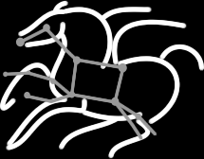
Scientific Workflows with Pegasus and HTCondor DAGMan
Karan Vahi
Science Automation Technologies Group
USC Information Sciences Institute

Slide 2
Scientific Workflows
Orchestrate complex, multi-stage scientific computations
Often expressed as directed acyclic graphs (DAGs)
Capture analysis pipelines for sharing and reuse
Can execute in parallel on distributed resources
Setup
Split
Filter & Convert
Map
Merge
Analyze
Epigenomics Workflow
Notes:
Expressed in high-level workflow languages

Slide 3
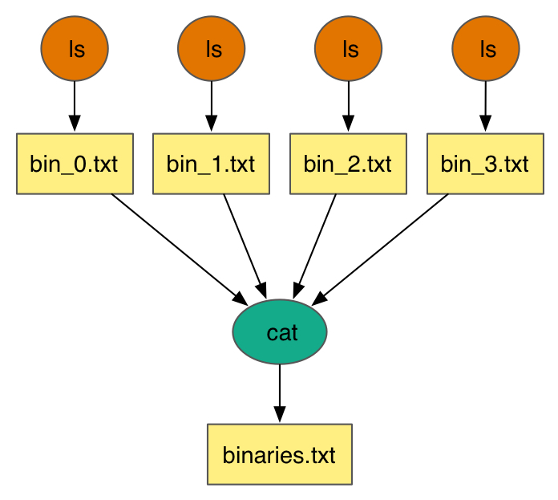
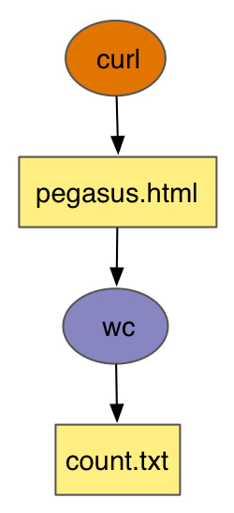
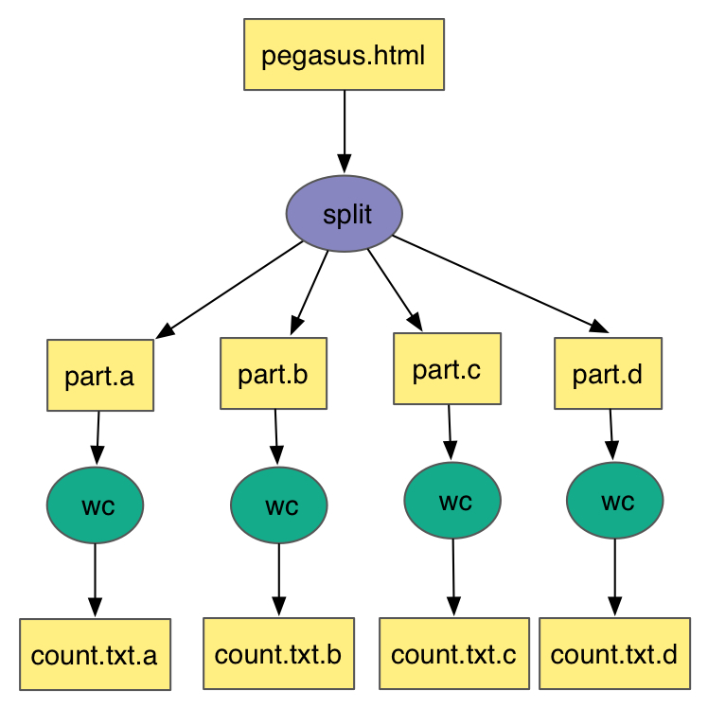
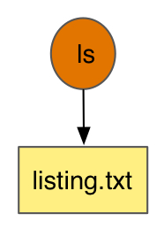
Simple Workflows – Building Blocks
Notes:
Simple Workflow constructs that serve as building workflows for more complex examples

Slide 4
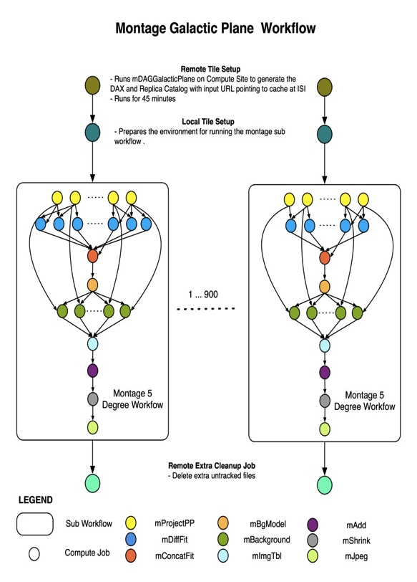

Complex Workflows
John Good (Caltech)
Montage Galactic Plane Workflow
18 million input images (~2.5 TB)
900 output images (2.5 GB each, 2.4 TB total)
10.5 million tasks (34,000 CPU hours)
Need to support hierarchical workflows and scale
× 17
Notes:
Here we have an example of montage galactic plane that leverages hierarchal workflows and is data intensive.
Runs on Amazon EC2.

Slide 5
Challenges while Executing Compute Pipelines
Portability
How can you run a pipeline on Amazon EC2 one day, and a PBS cluster the next?
Data Management
How do you ship in the small/large amounts data required by your pipeline?
Different protocols for different sites: Can I use SRM? How about GridFTP? HTTP and Squid proxies?
Can I use Cloud based storage like S3 on EC2?
Debug and Monitor Computations.
Users need automated tools to go through the log files
Need to correlate data across lots of log files
Need to know what host a job ran on and how it was invoked
Restructure Pipelines for Improved Performance
Short running tasks?
Data placement?

Slide 6
Pegasus Workflow Management System (est. 2001)
Maps a resource-independent “abstract” workflow onto resources and executes the “executable” workflow
Benefits
Automation
Automates complex, multi-stage processing pipelines
Enables parallel, distributed computations
Automatically executes data transfers
Reusable portable description of workflows that aids reproducibility
Recovery
Automatic job retries
Ability to restart pipelines without repeating steps
Debug
Records how data was produced (provenance)
Simple easy to use command line tools for monitoring and debugging
Web Based Dashboard Available

Slide 7
Pegasus WMS Environment

Slide 8
Pegasus Workflow Management System
Abstract Workflows - Pegasus input workflow description
Workflow “high-level language”
Only identifies the computation, devoid of resource descriptions, devoid of data locations
File Aware
Pegasus is a workflow “compiler” (plan/map)
Target is DAGMan DAGs and Condor submit files
Transforms the workflow for performance and reliability
Automatically locates physical locations for both workflow components and data
Collects runtime provenance

Slide 9
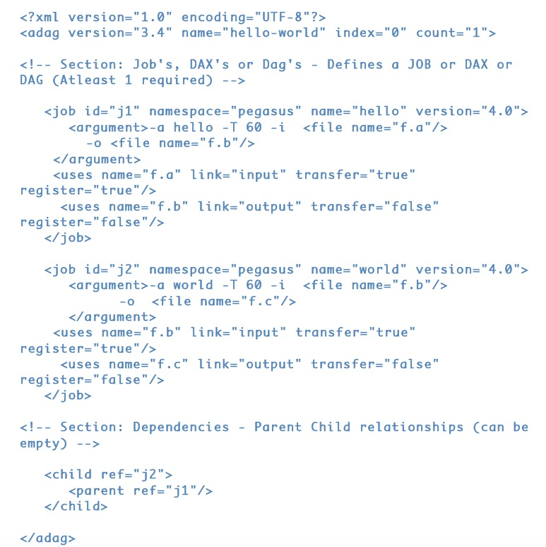
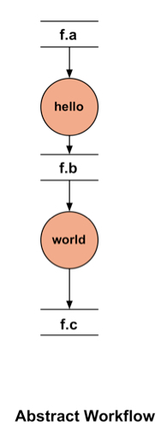
DAX – XML format to describe Abstract Workflows

Slide 10
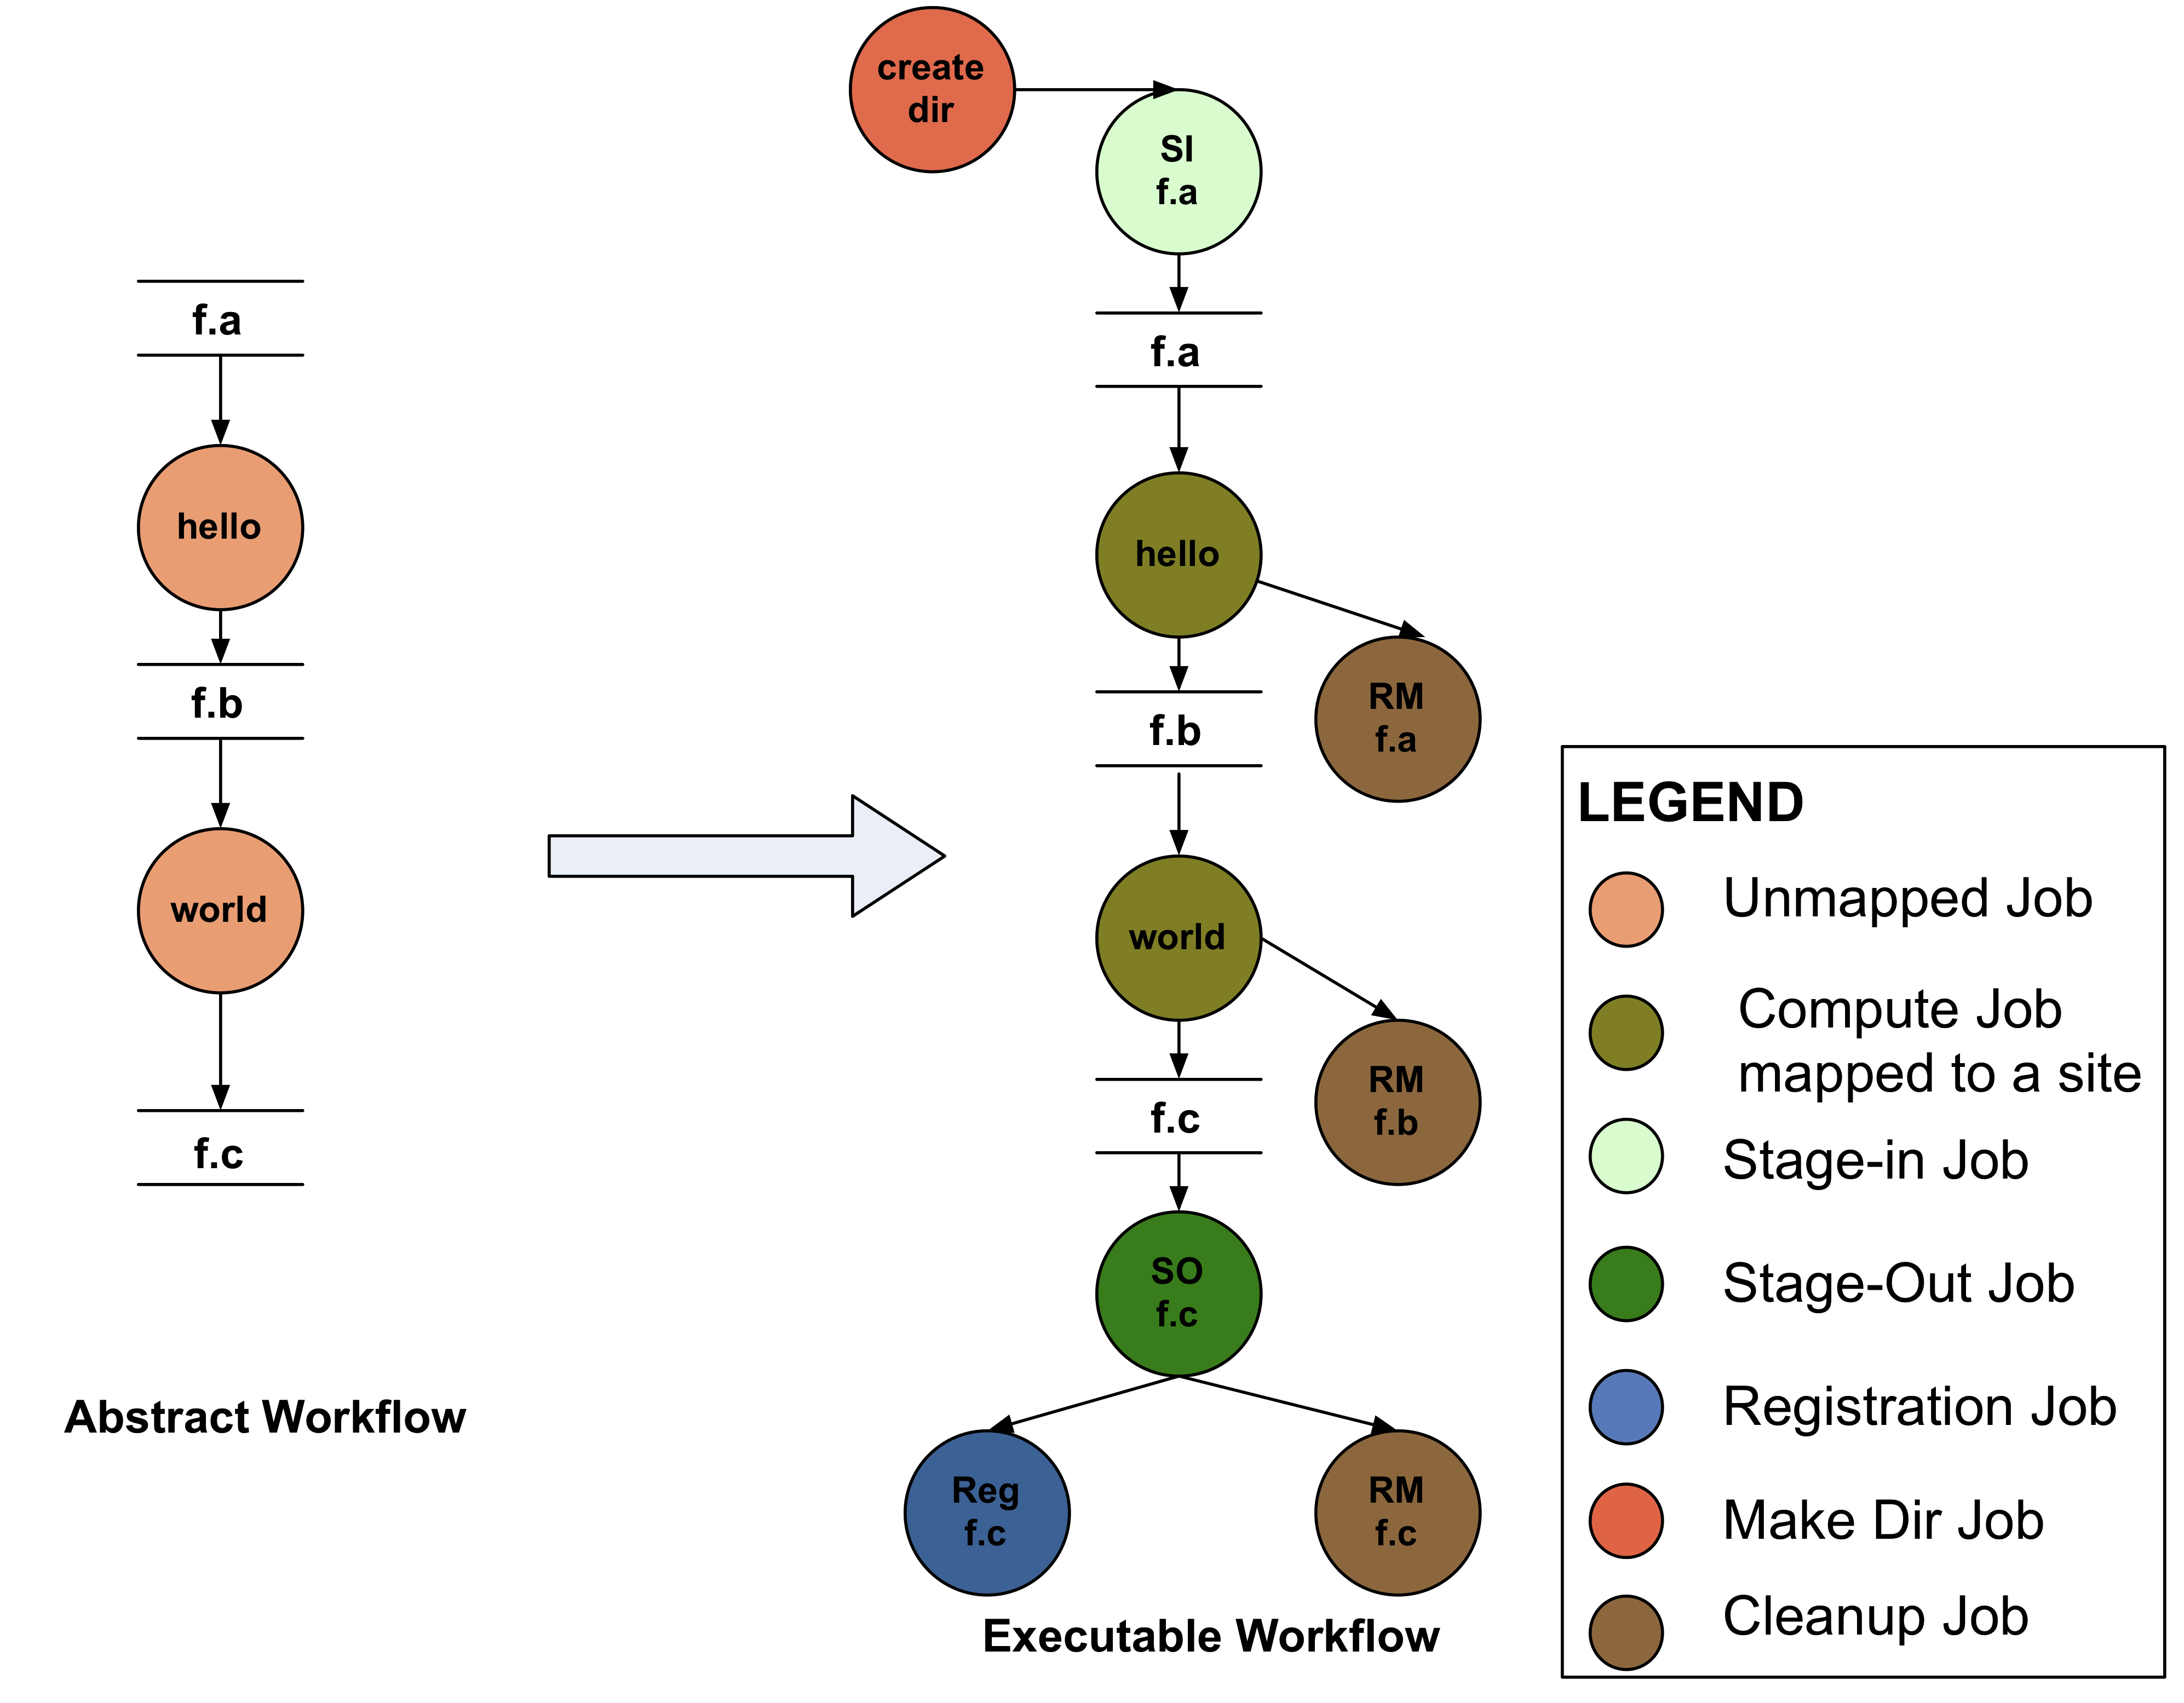
Abstract to Executable Workflow Mapping
Abstraction provides
Ease of Use (do not need to worry about low-level execution details)
Portability (can use the same workflow description to run on a number of resources and/or across them)
Gives opportunities for optimization and fault tolerance
automatically restructure the workflow
automatically provide fault recovery (retry, choose different resource)

Slide 11
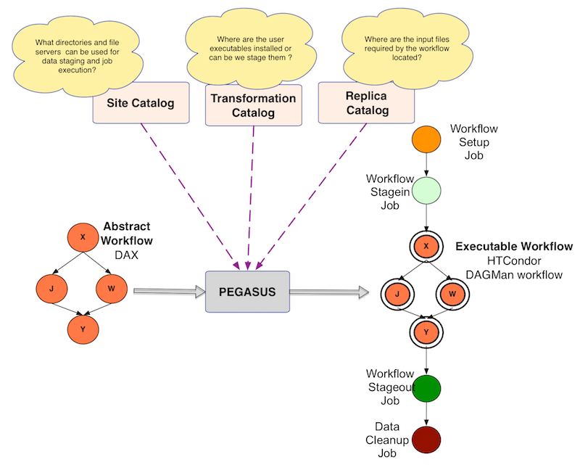
Abstract to Executable Workflow Mapping - Discovery

Slide 12
Simple Steps to Run Pegasus
Specify your computation in terms of DAX
Write a simple DAX generator
Python, Java , Perl based API provided with Pegasus
Set up your catalogs
Replica catalog, transformation catalog and site catalog.
Plan and Submit your workflow
Use pegasus-plan to generate your executable workflow that is mapped onto the target resources and submits it for execution
Monitor and Analyze your workflow
Use pegasus-status | pegasus-analyzer to monitor the execution of your workflow
Workflow Statistics
Run pegasus-statistics to generate statistics about your workflow run.

Slide 13
Workflow Monitoring
Leverage Stampede Monitoring framework with DB backend
Populates data at runtime. A background daemon monitors the logs files and populates information about the workflow to a database
Stores workflow structure, and runtime stats for each task.
Tools for querying the monitoring framework
pegasus-status
Status of the workflow
pegasus-statistics
Detailed statistics about your finished workflow
------------------------------------------------------------------------------
Type Succeeded Failed Incomplete Total Retries Total+Retries
Tasks 135002 0 0 135002 0 135002
Jobs 4529 0 0 4529 0 4529
Sub-Workflows 2 0 0 2 0 2
------------------------------------------------------------------------------
Workflow wall time : 13 hrs, 2 mins, (46973 secs)
Workflow cumulative job wall time : 384 days, 5 hrs, (33195705 secs)
Cumulative job walltime as seen from submit side : 384 days, 18 hrs, (33243709 secs)

Slide 14
Workflow Debugging Through Pegasus
After a workflow has completed, we can run pegasus-analyzer to analyze the workflow and provide a summary of the run
pegasus-analyzer's output contains
a brief summary section
showing how many jobs have succeeded
and how many have failed.
For each failed job
showing its last known state
exitcode
working directory
the location of its submit, output, and error files.
any stdout and stderr from the job.
Alleviates the need for searching through large DAGMan and Condor logs!

Slide 15
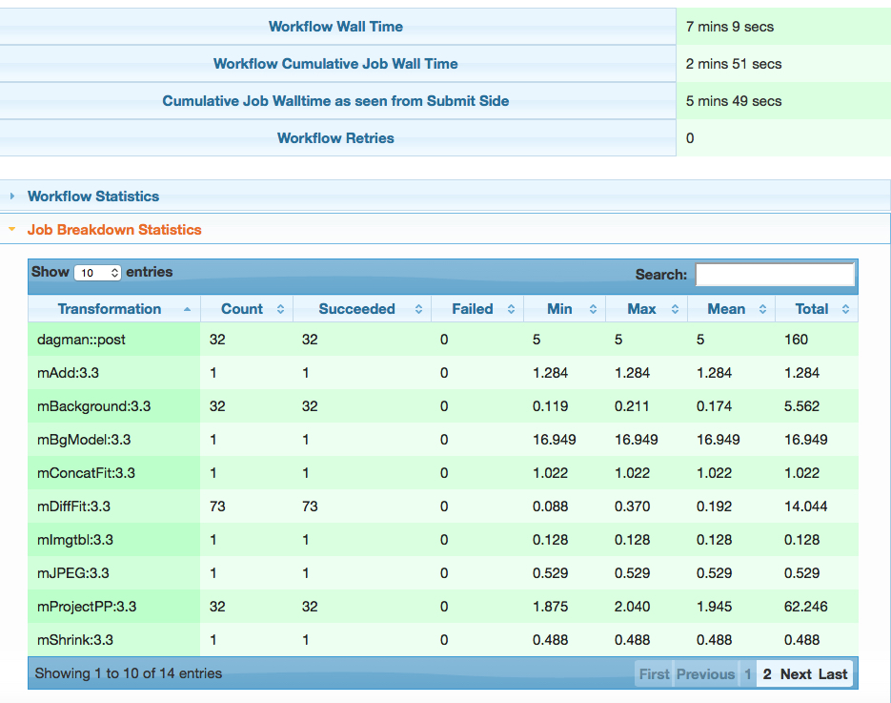
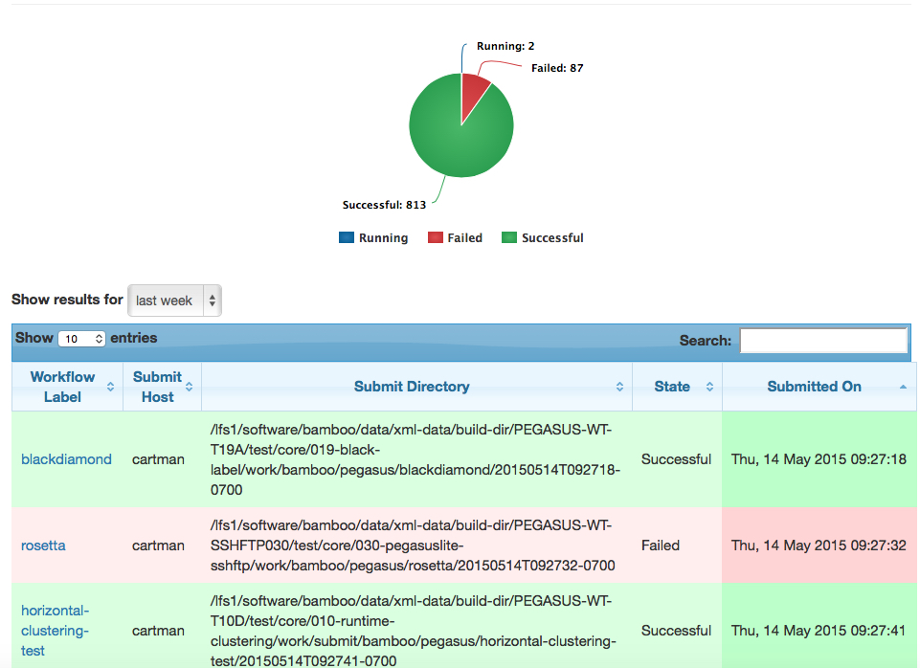
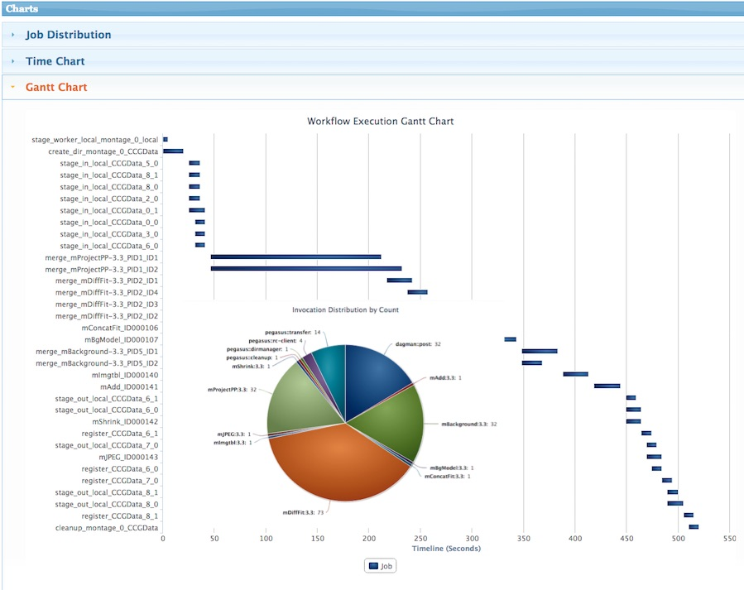
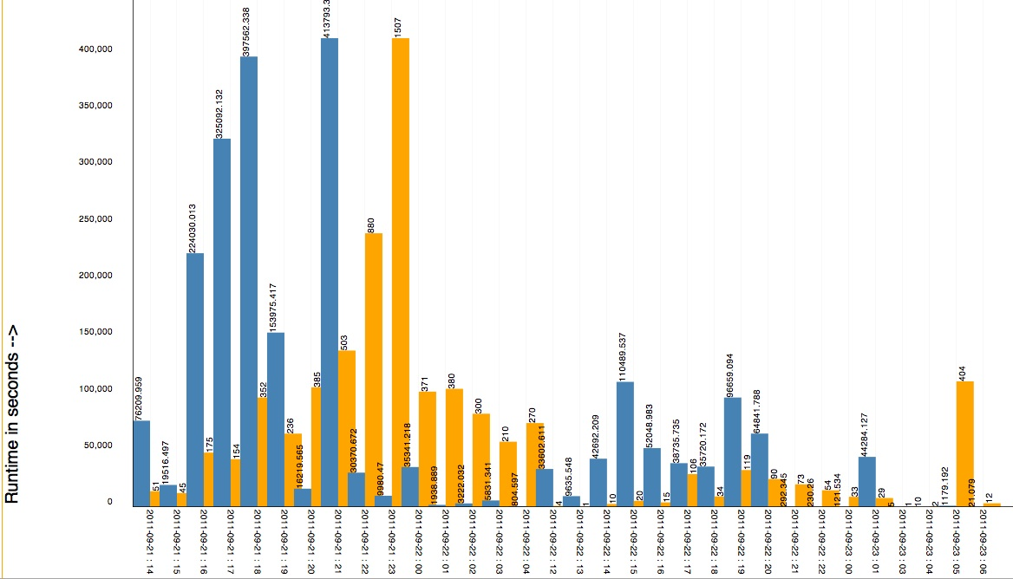
Pegasus Dashboard
Workflow Listing Page
Shows Successful, Failed and Running Workflows
Workflow Statistics
Workflow Gantt Chart
And Job Distribution
Jobs and Runtime over Time

Slide 16
Workflow Restructuring to improve application performance
Cluster small running jobs together to achieve better performance
Why?
Each job has scheduling overhead – need to make this overhead worthwhile
Ideally users should run a job on the grid that takes at least 10/30/60/? minutes to execute
Clustered tasks can reuse common input data – less data transfers
Horizontal clustering
Label-based clustering

Slide 17
Workflow Reduction (Data Reuse)
Useful when you have done a part of computation and then realize the need to change the structure. Re-plan instead of submitting rescue DAG!
Notes:
Sometimes it is cheaper to access the data than to regenerate it
Keeping track of data as it is generated supports workflow-level checkpointing
Kent changed 080501 – added period

Slide 18
File cleanup
Problem: Running out of disk space during workflow execution
Why does it occur
Workflows could bring in huge amounts of data
Data is generated during workflow execution
Users don’t worry about cleaning up after they are done
Solution
Do cleanup after workflows finish
Add a leaf Cleanup Job ( Available in 4.4 Release onwards)
Interleave cleanup automatically during workflow execution.
Requires an analysis of the workflow to determine, when a file is no longer required
Cluster the cleanup jobs by level for large workflows
In 4.6 release, users should be able to specify maximum disk space that should not be exceeded. Pegasus will restructure the workflow accordingly.
Real Life Example: Used by a UCLA genomics researcher to delete TB’s of data automatically for long running workflows!!
Notes:
Kent changed 080501

Slide 19
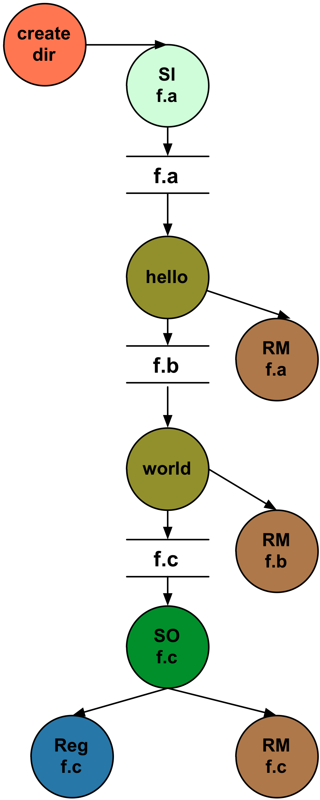
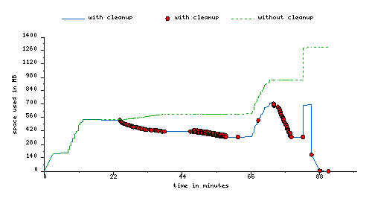
File cleanup (cont)
Montage 1 degree workflow run with cleanup

Slide 20
Workflow and Task Notifications
Users want to be notified at certain points in the workflow or on certain events.
Support for adding notification to workflow and tasks
Event based callouts
On Start, On End, On Failure, On Success
Provided with email and jabber notification scripts
Can run any user provided scripts
Defined in the DAX

Slide 21
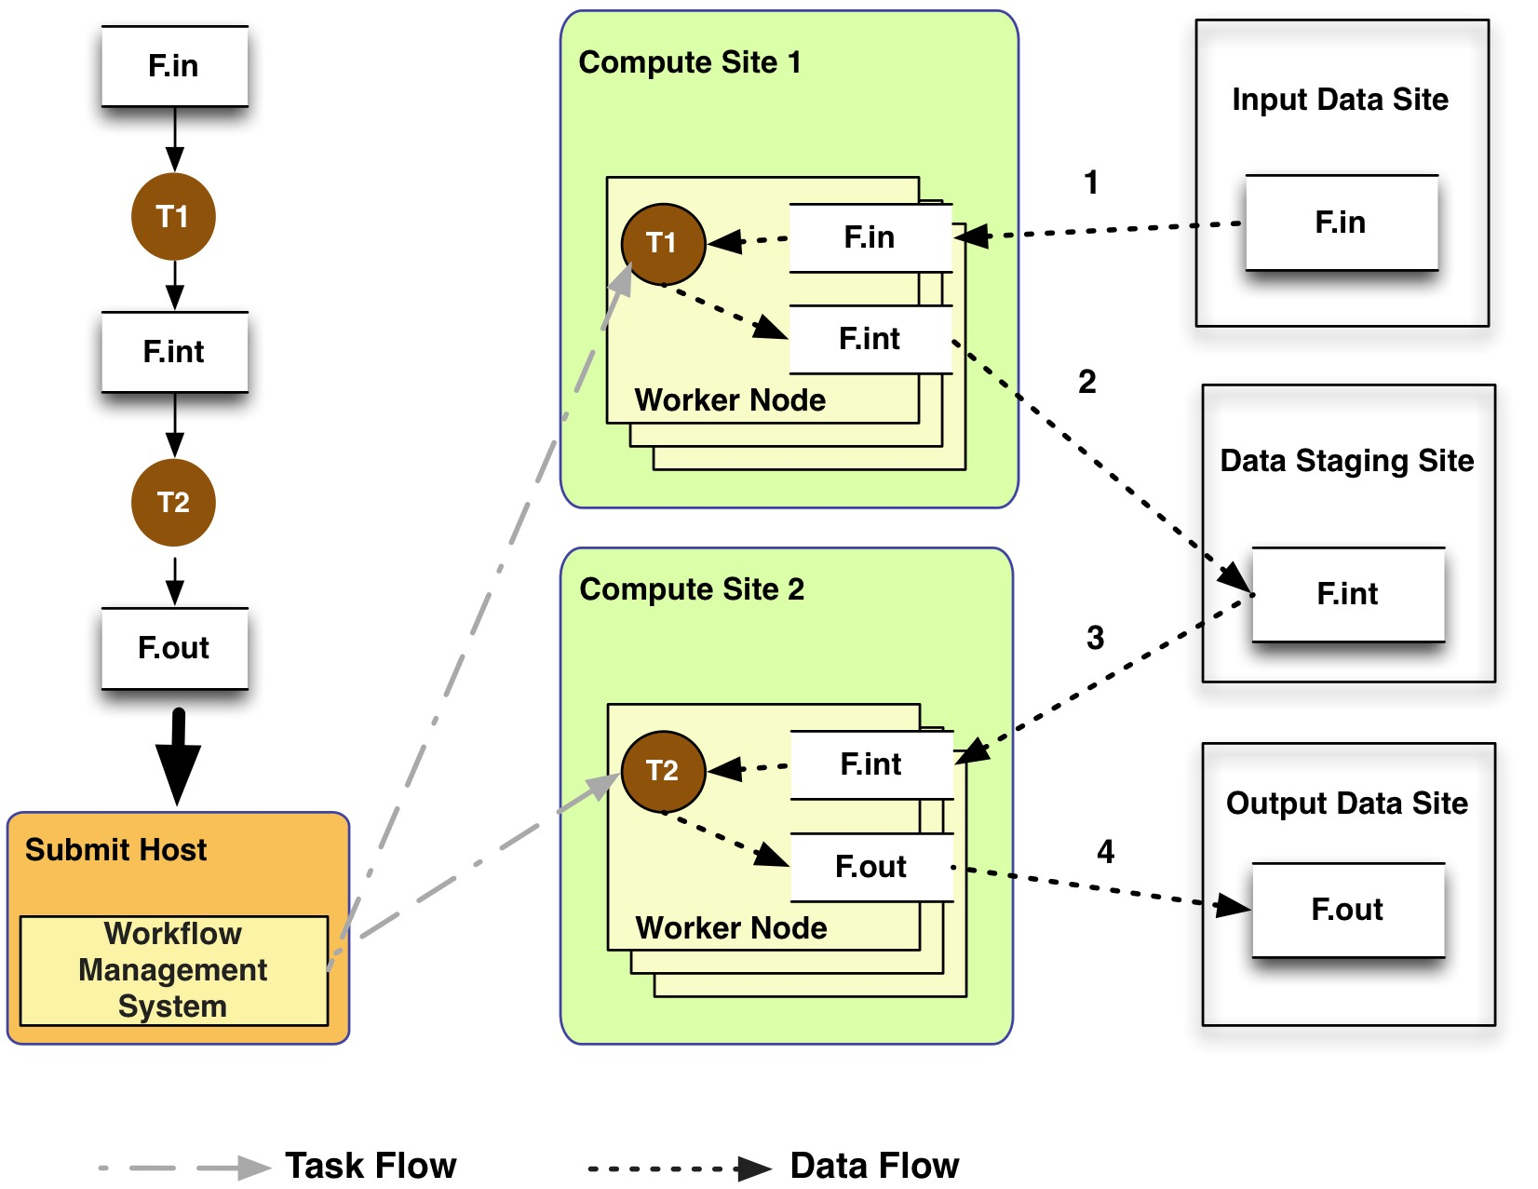
Data Management - General Workflow Execution Model
Most of the tasks in scientific workflow applications require POSIX file semantics
Each task in the workflow opens one or more input files
Read or write a portion of it and then close the file.
Data Staging Site can be the shared filesystem on the compute cluster!
Input Data Site, Compute Site and Output Data Sites can be co-located
Example: Input data is already present on the compute site.
Notes:
Remember to describe each type of site

Slide 22
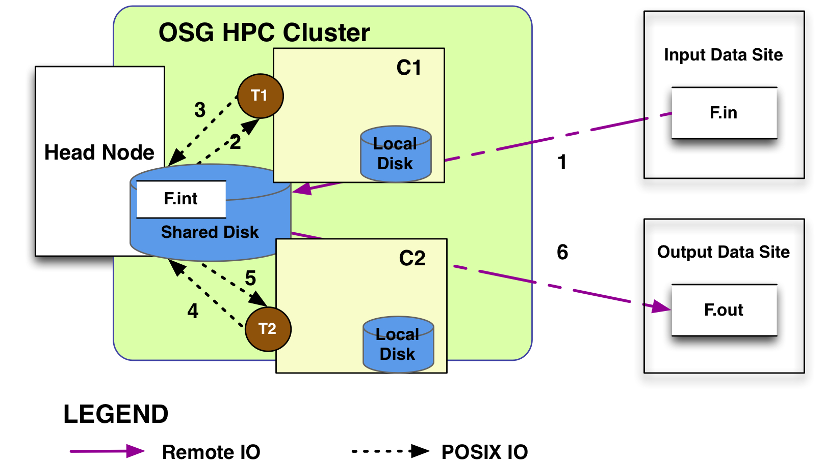
How does Pegasus view a compute resource as?
For Pegasus a compute resource or a site is associated with the following
An entry point or a scheduler contact to submit jobs to e.g PBS/LSF/Condor
File servers to stage data to the cluster
Different types of directories on the site
Shared-scratch - shared across all the worker nodes in the site
Local – a directory/filesystem local to the node where a job executes
Site wide information like environment variables to be set when a job is run.

Slide 23
Supported Data Staging Approaches - I
Shared Filesystem setup (typical of XSEDE and HPC sites)
USC HPCC
Cluster
Worker nodes and the head node have a shared filesystem, usually a parallel filesystem with great I/O characteristics
Can leverage symlinking against existing datasets
Staging site is the shared-fs.
Compute Site
WN
Submit
Host
Shared
FS
WN
hpc-pegasus
Non-shared filesystem setup with staging site (typical of OSG and EC 2)
Worker nodes don’t share a filesystem.
Data is pulled from / pushed to the existing storage element.
A separate staging site such as S3.
Compute Site
Submit
Host
WN
Staging
Site
WN
Amazon
EC2 with S3
Jobs
Data
Notes:
Kent changed 080501 – removed periods

Slide 24
Supported Data Staging Approaches - II
Submit
Host
Condor IO ( Typical of large Condor Pools like CHTC)
Worker nodes don’t share a filesystem
Symlink against datasets available locally
Data is pulled from / pushed to the submit host via Condor file transfers
Staging site is the submit host.
Local FS
Jobs
Data
Compute Site
WN
WN
Supported Transfer Protocols
HTTP
SCP
GridFTP
IRODS
S3
Condor File IO
File Copy
Using Pegasus allows you to move from one deployment to another without changing the workflow description!

Slide 25
What Does Pegasus provide an Application - I
Portability / Reuse
User created workflows can easily be mapped to and run in different environments without alteration.
Data Management
Pegasus handles replica selection, data transfers and output registrations in data catalogs. These tasks are added to a workflow as auxiliary jobs by the Pegasus planner.
Performance
The Pegasus mapper can reorder, group, and prioritize tasks in order to increase the overall workflow performance.
Notes:
Kent changed 080501 – removed period

Slide 26
What Does Pegasus provide an Application - II
Provenance
Provenance data is collected in a database, and the data can be summaries with tools such as pegasus-statistics, pegasus-plots, or directly with SQL queries.
Reliability and Debugging Tools
Jobs and data transfers are automatically retried in case of failures. Debugging tools such as pegasus-analyzer helps the user to debug the workflow in case of non-recoverable failures.
Scalability
Hierarchal workflows
Scale to hundreds of thousands of nodes in a workflow.
Notes:
Kent changed 080501 – removed period

Slide 27
More Information
Pegasus Website:
http://pegasus.isi.edu
Tutorial:
http://pegasus.isi.edu/wms/docs/latest/tutorial.php
Documentation:
http://pegasus.isi.edu/documentation
Support: pegasus-users@isi.edu pegasus-support@isi.edu
HipChat Support Room

